Slide 1
Agentic RAG Chatbot for Multi-Format Document QA using Model Context Protocol (MCP)
AI-powered agent architecture for document intelligence
Done by
Saniya Mirza

Slide 2
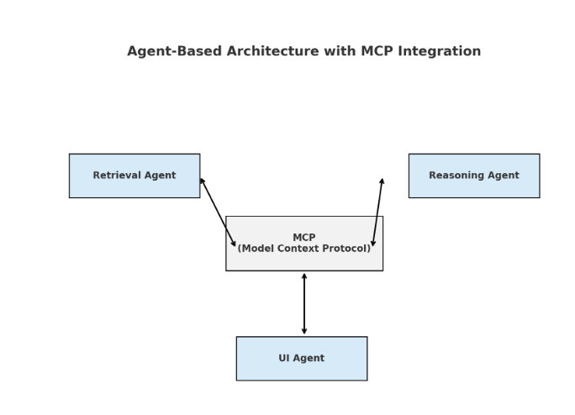
Agent-Based Architecture with MCP Integration

Slide 3
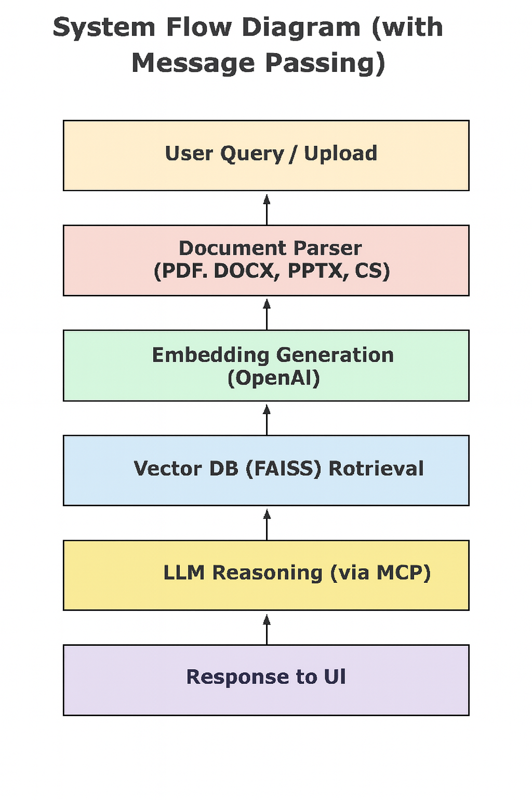
System Flow Diagram

Slide 4
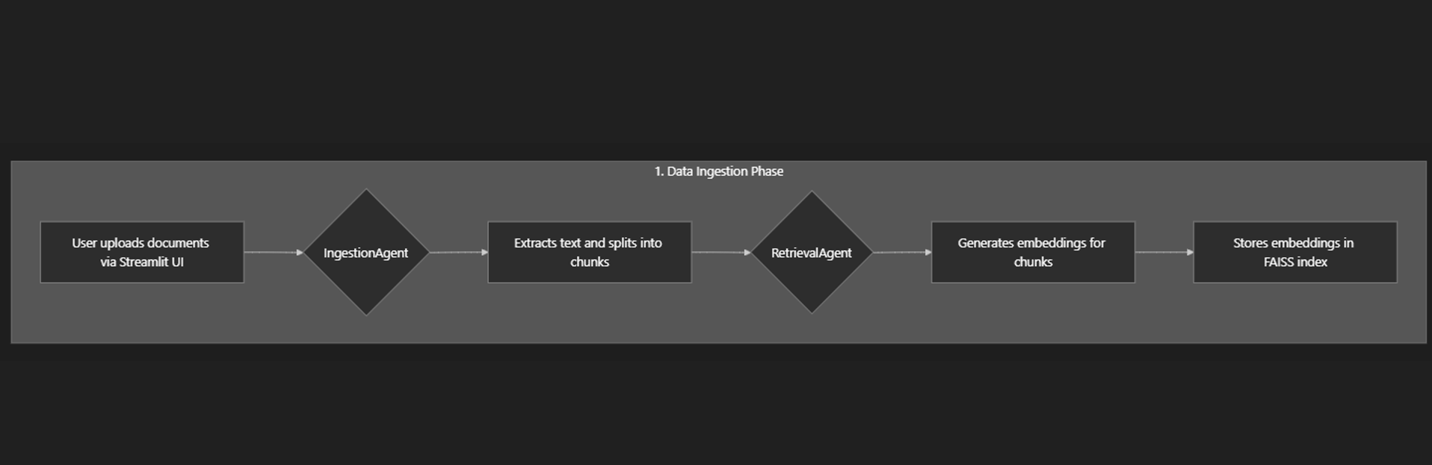
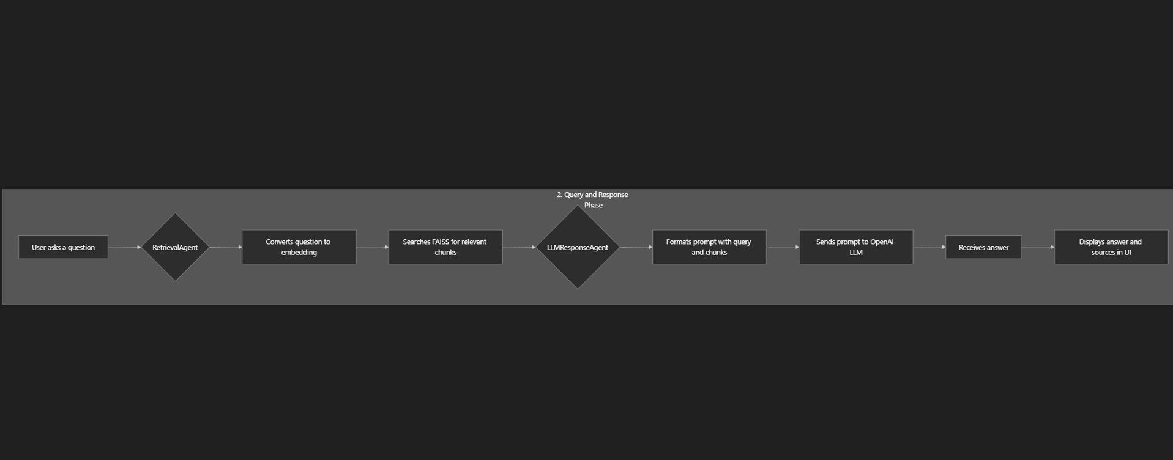

Slide 5
Tech Stack
Frontend/UI: Streamlit
Backend: Python
Embeddings: SentenceTransformers, OpenAI
Vector DB: FAISS
LLMs: OpenAI GPT-4
File Handling: PyPDF2, python-docx, python-pptx, pandas
Environment Management: dotenv

Slide 6
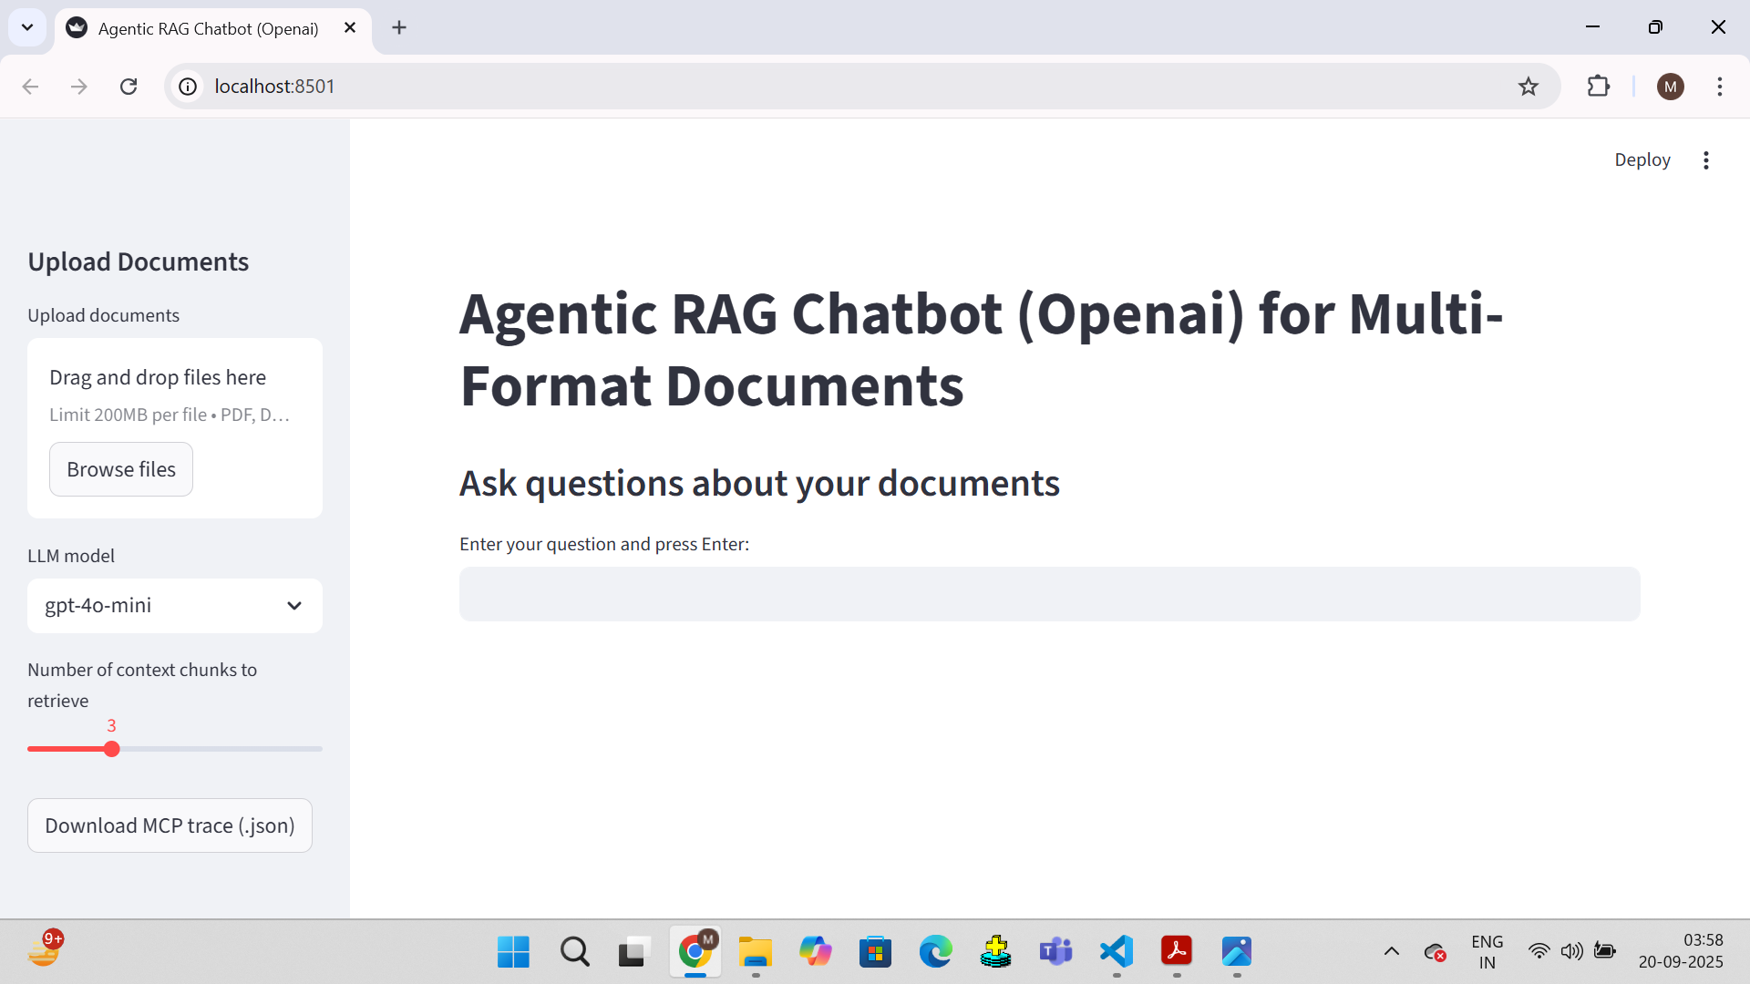
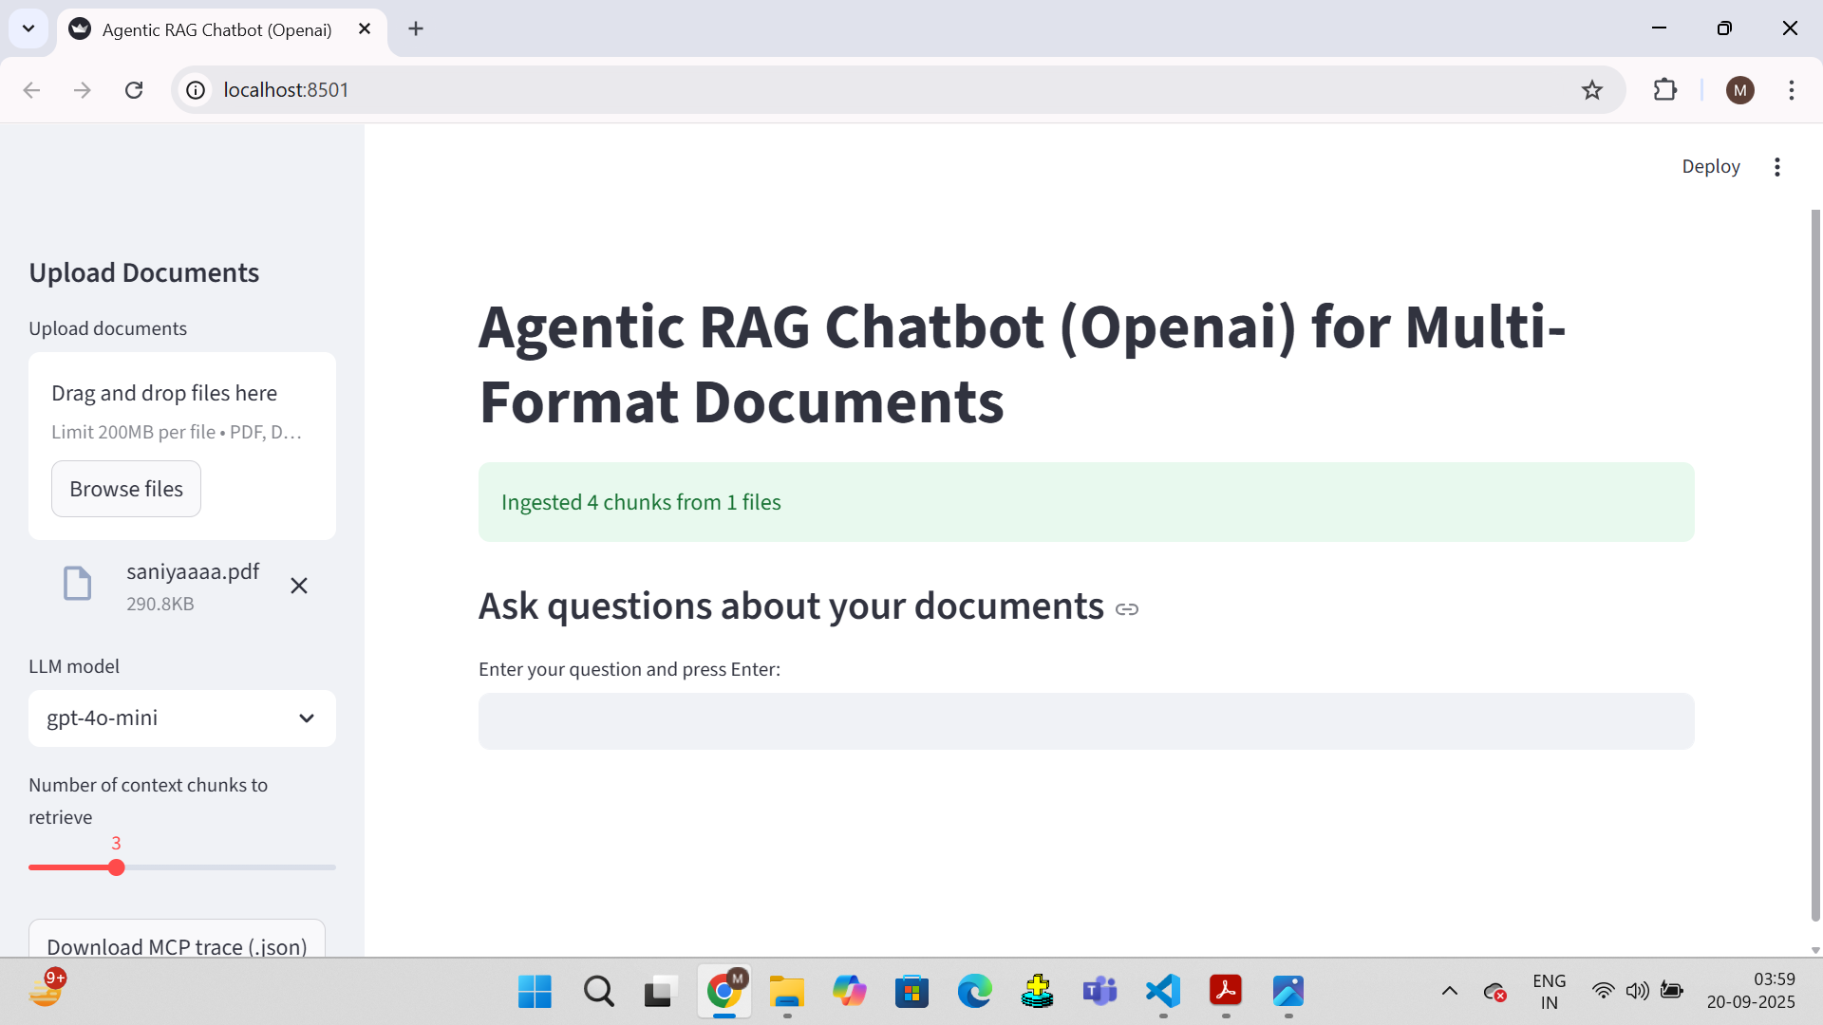
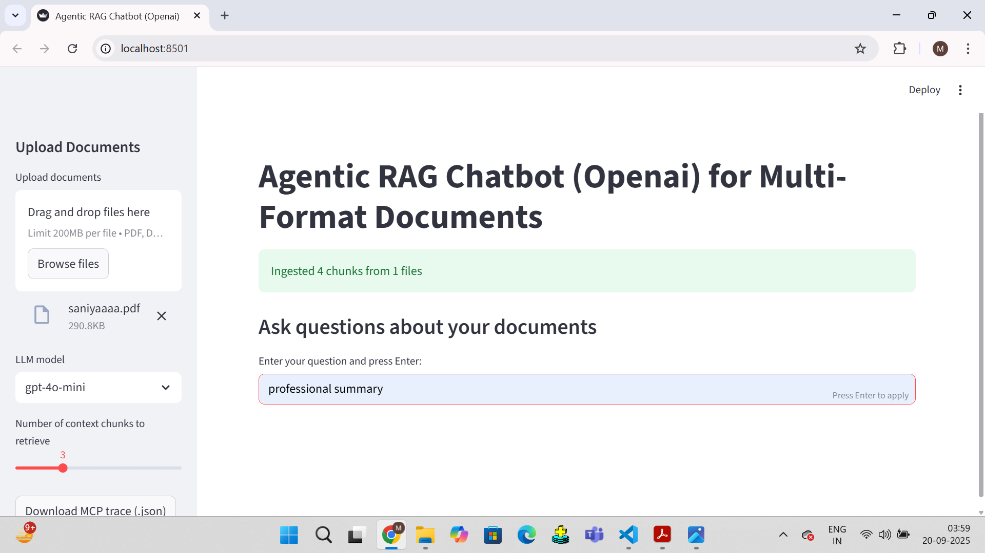
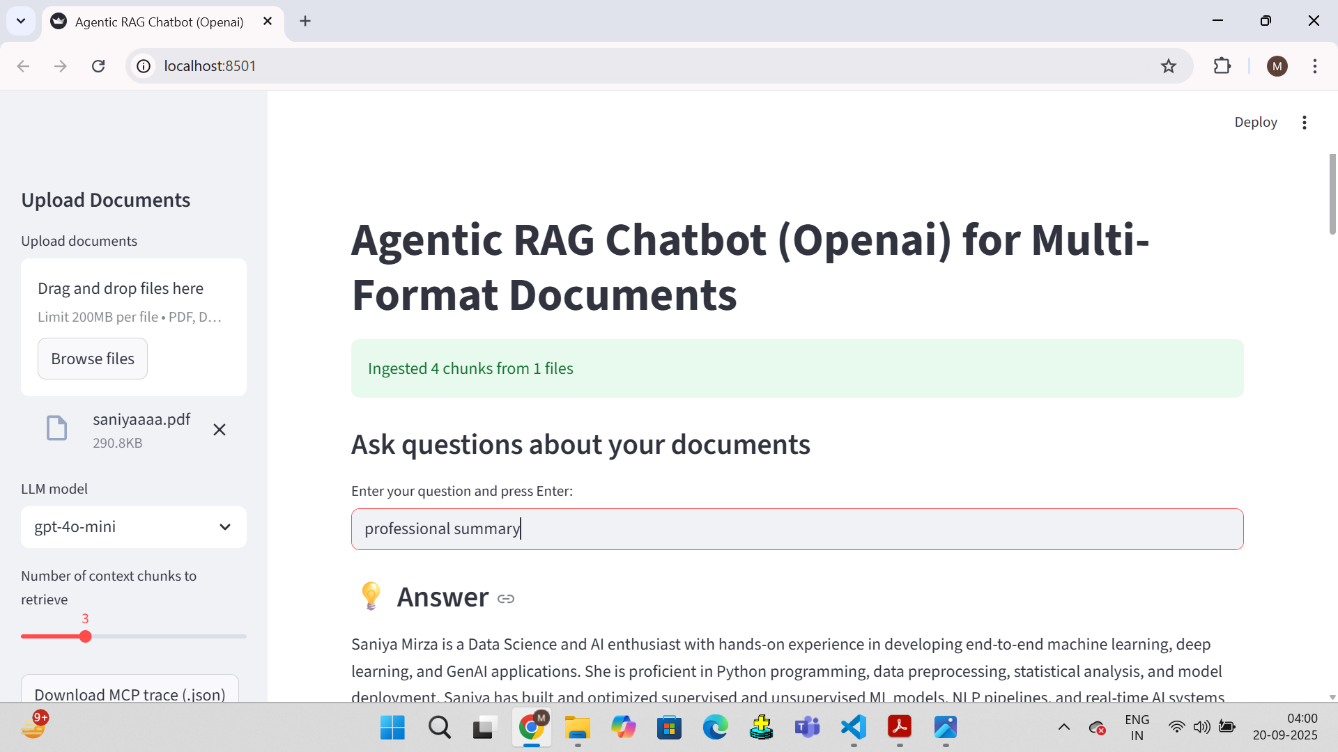
UI Screenshots

Slide 7
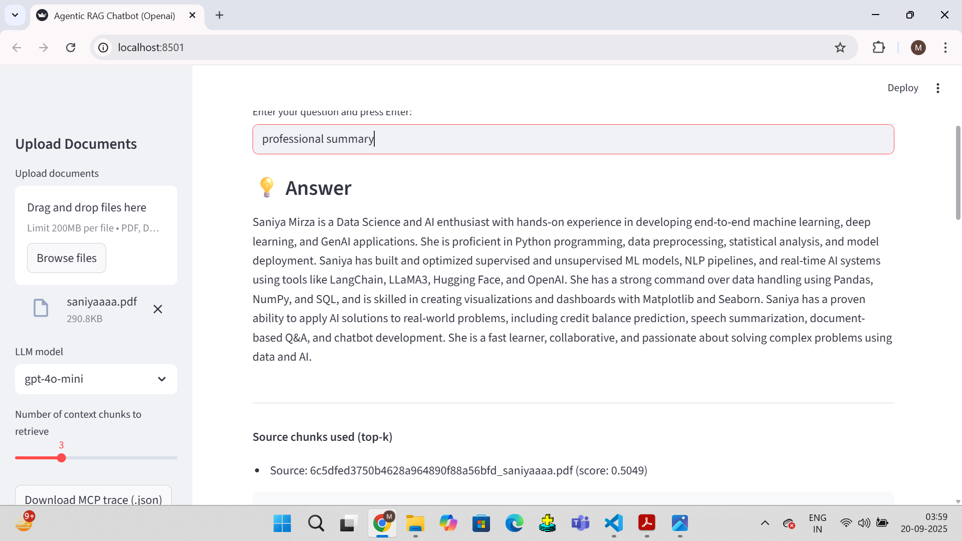
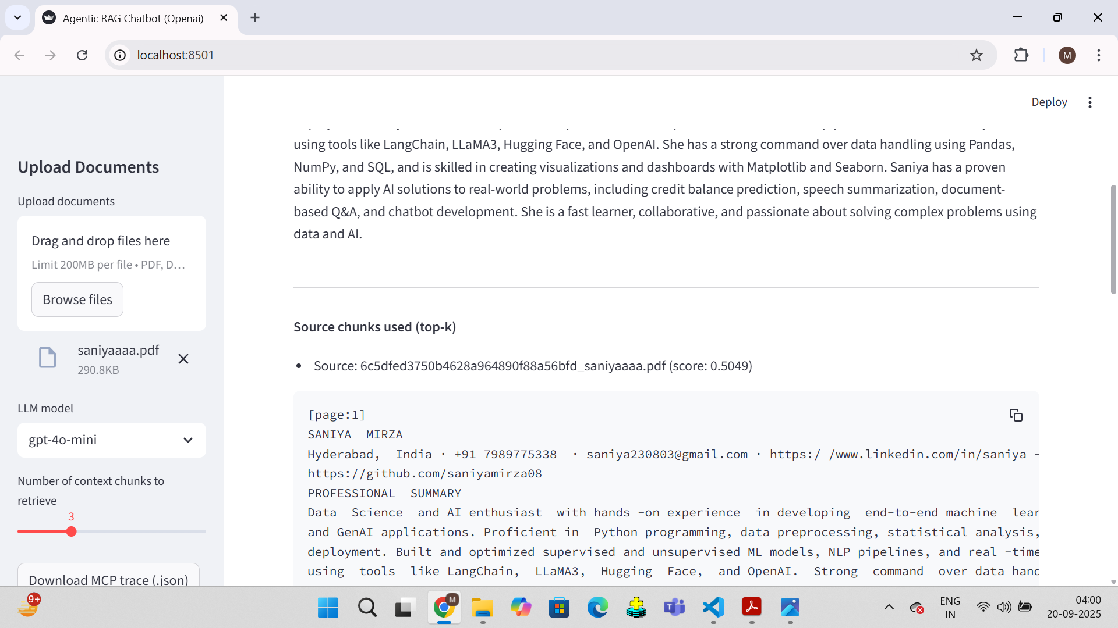
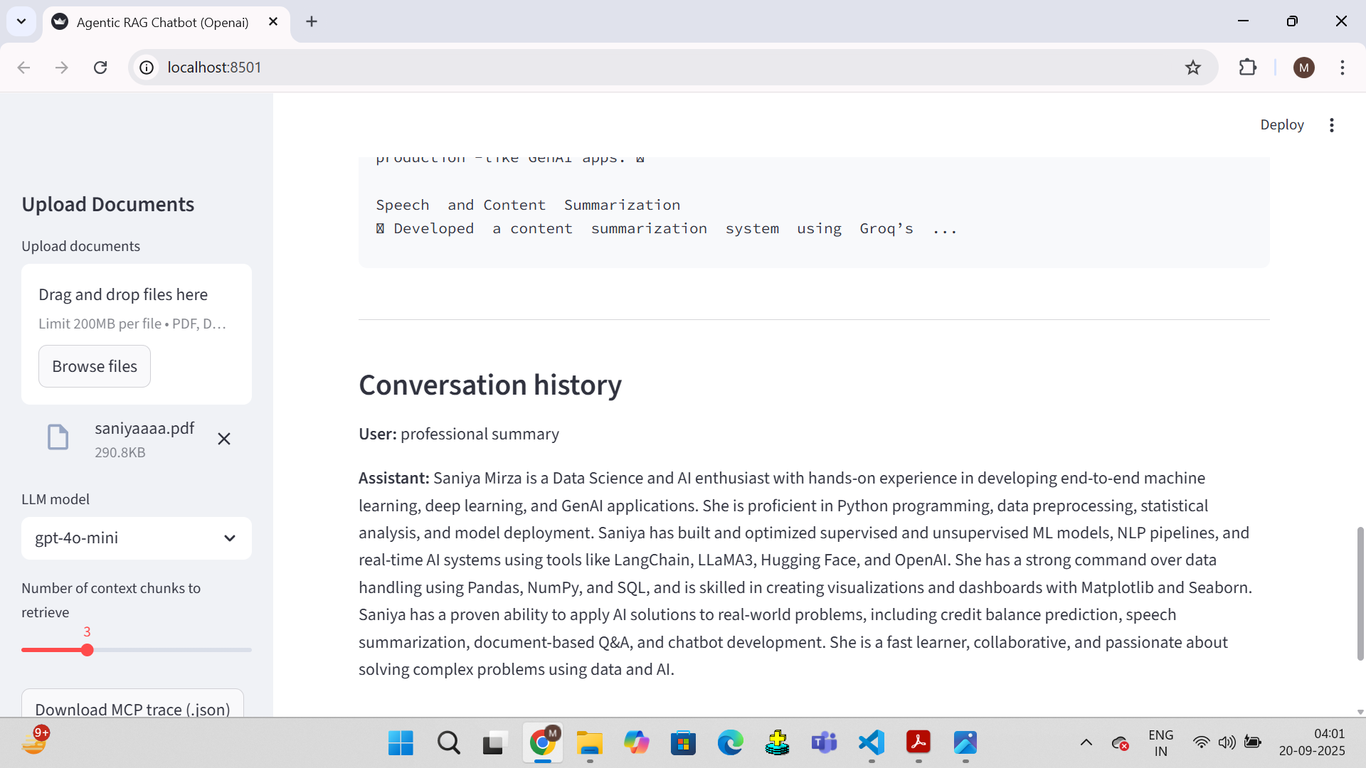

Slide 8
Challenges Faced:
Handling different document formats
Managing large documents & embeddings
Ensuring smooth MCP integration
Keeping responses accurate and fast

